Slide 1



SVD LSI dimension reduction
覃雄派

Slide 2
提纲
Singular Value Decomposition(SVD)
Latent Semantic Index (LSI)
Dimension Reduction
SVD LSI dimension reduction

Slide 3
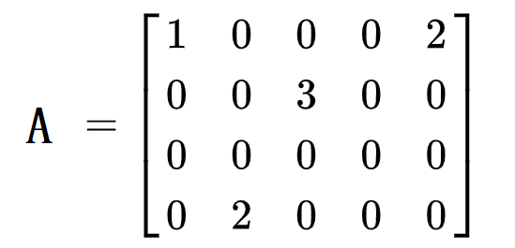
SVD LSI dimension reduction
Word document co- occurrence matrix
doc
word

Slide 4
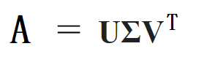
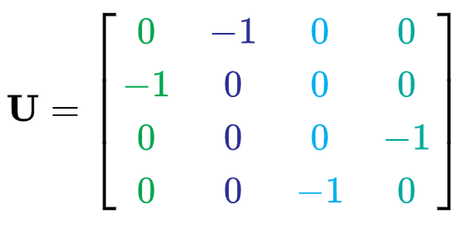
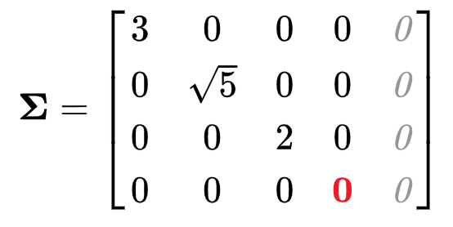
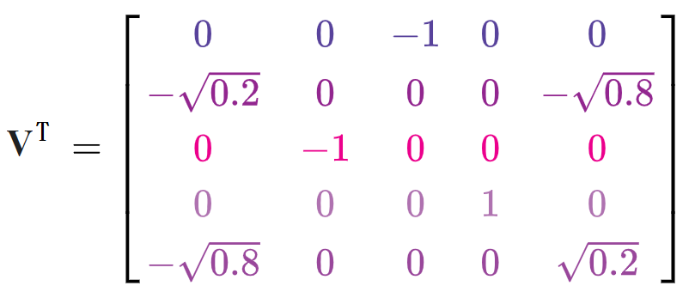
SVD LSI dimension reduction
Word document co- occurrence matrix →SVD
4*4
4*5
5*5

Slide 5
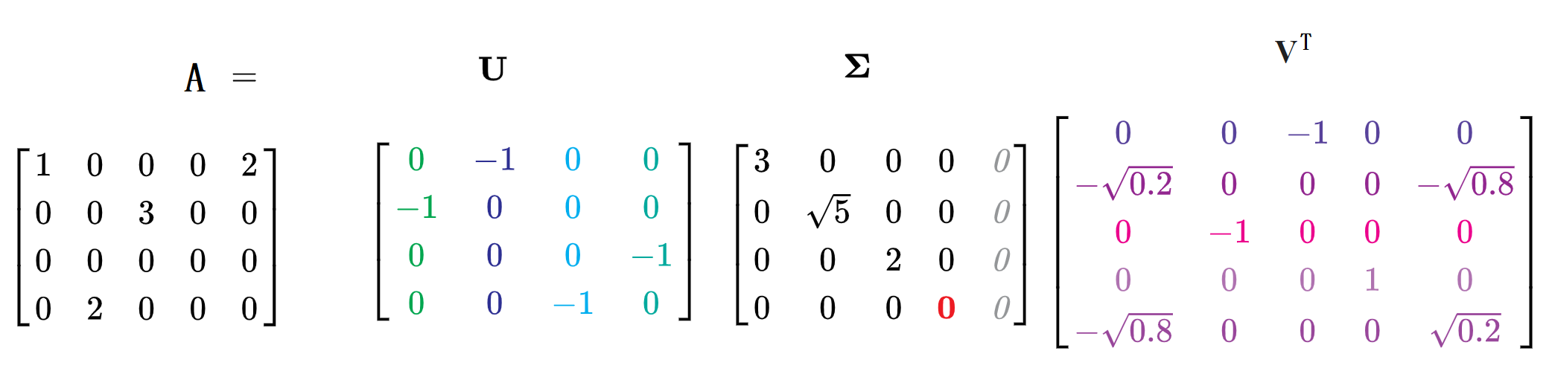
SVD LSI dimension reduction
Word document co- occurrence matrix →SVD
4*4
4*5
5*5

Slide 6

SVD LSI dimension reduction

Slide 7
SVD LSI dimension reduction
Latent Semantic index
仅保留非0特征根
及其解读
doc
latent
word
4*3
3*3
3*5

Slide 8
SVD LSI dimension reduction

Slide 9

SVD LSI dimension reduction
dimension reduction
保留K=2个维度
约等于
$$≈$$
4*2
2*2
2*5

Slide 10
SVD LSI dimension reduction

